Slide 1

4-DIGIT MANIA
Next generation retro-gaming

Slide 2
Instructions
You will start with 50 gold coins
Each guess will cost you 5 gold coins
You will need to input one 4-digit number, each digit being unique in each guess.
Each time you guess a number in its correct position, you will be awarded 1 gold coin.
If you guess a number but in an incorrect position, you will be awarded 1 silver coin.
You will be awarded 50 gold coins if you guess the full number correctly. However, try not to run out of gold coins to play!

Slide 3
How to use the game
Once you register/login successfully, 4-DIGIT MANIA will start running. It will ask you to enter your first guess.
If you want to stop the game, press on the stop button placed on the bottom of the window.

Slide 4
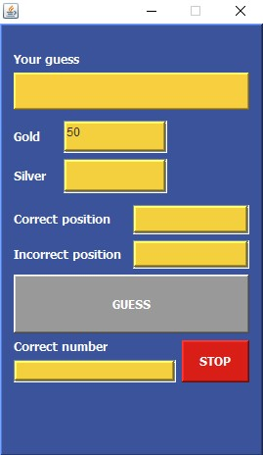
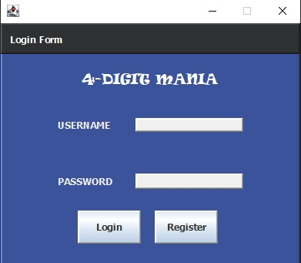
The application interface:
Login Form
Game Interface

Slide 5
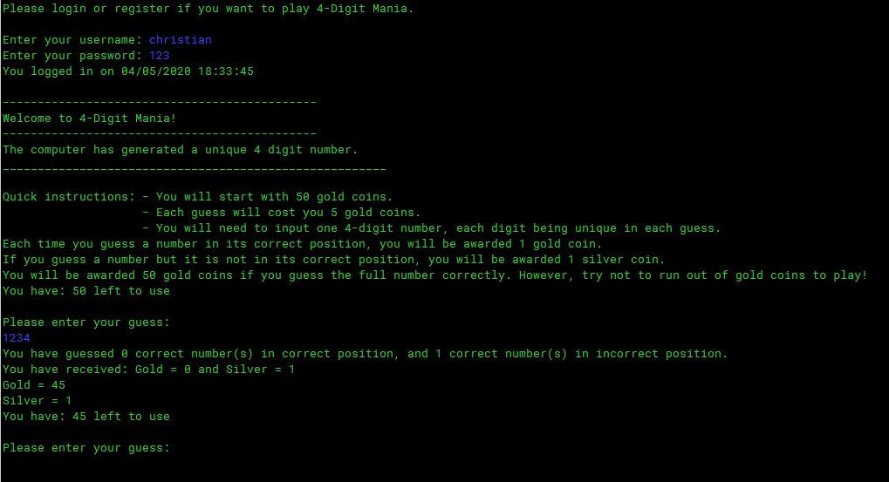
Same program but with output on terminal

